Slide 1


Walmart Customer Analysis
By
Aman Yadav.

Slide 2
Agenda
Who are the customers .
Which product are sold .
What do Customers purchase .
Customer Segmentations .

Slide 3
Who are the customers ?
Gender
Age
City
Marrital Status

Slide 4
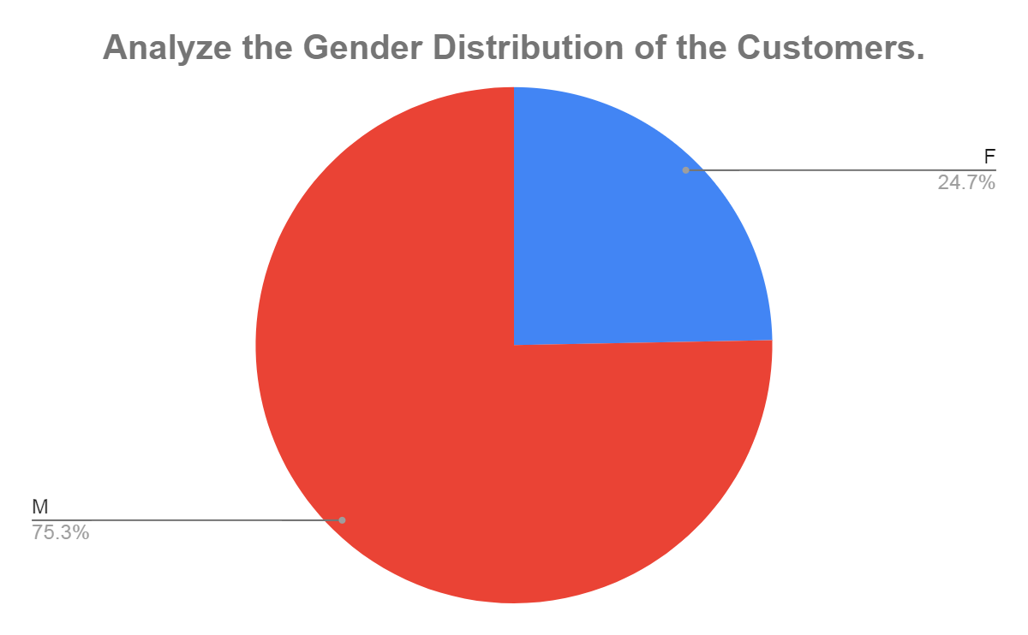
Most of the Customers are Male’s
Findings:-
The majority of the customers are male, making up 75.3% of the total customer base.
Female customers represent 24.7% of the total customer base.
Insights:-
This analysis indicates a significant skew towards male customers in the dataset.
The business may consider investigating the reasons for this disparity and, if desired, explore strategies to attract more female customers to achieve a more balanced customer base.

Slide 5
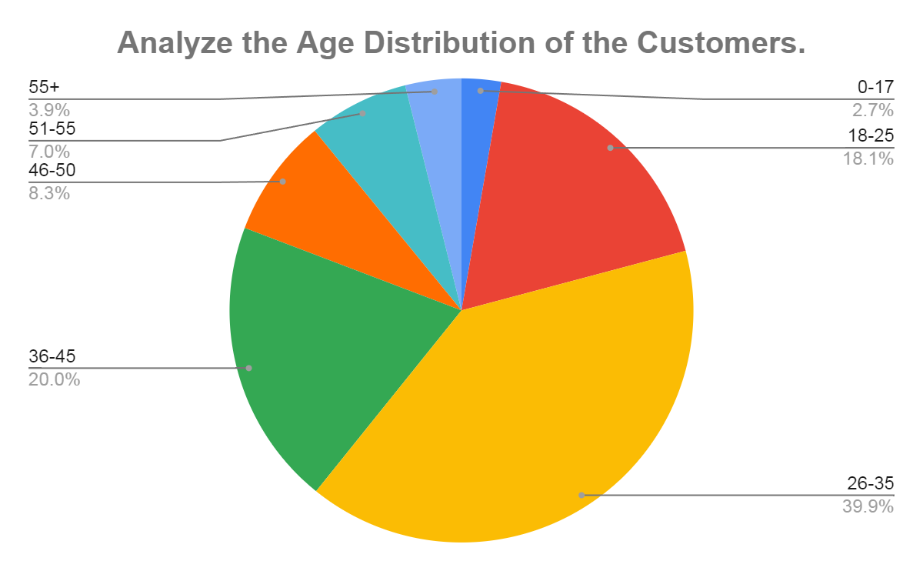
Majority of Customer’s are in 26-45 age group.
Findings:-
This indicates a higher concentration of customers in the 26-45 age group, making up approximately 60 % of the total customer base this indicates that young adults in this age range are the primary customers.
Insights:-
The data reveals that the majority of customers fall within the 18-45 age range, with a particularly high concentration in the 26-35 age group. This information can be valuable for targeted marketing strategies, product development, and customer service optimization, focusing on the needs and preferences of these predominant age groups. Additionally, efforts to engage older customers could be explored to balance the age distribution further.

Slide 6
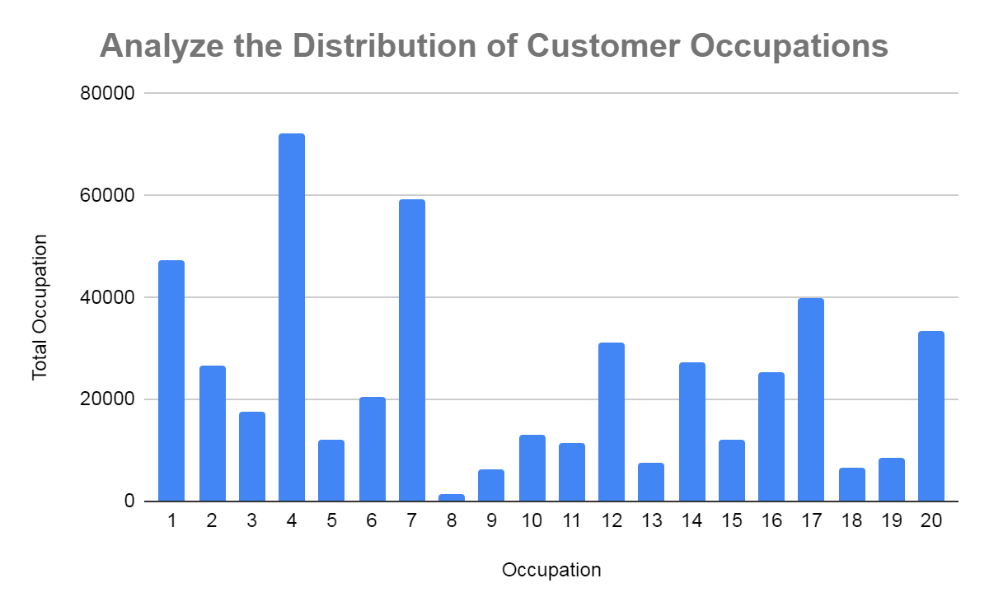
Occupations 4 has the highest count with 19 % of customers base.
Findings:-
Occupations 4 has the highest count with approximately 19 % of the customers base.
And rest all occupations are combined total about 81% of the customers base.
Insights:-
Occupations 4, 7, and 0 have high customer representation, indicating strong existing engagement or interest.
These occupations should be prioritized in marketing strategies. By leveraging targeted marketing campaigns,
personalized offers, and loyalty programs, the company can further strengthen its hold in these segments and
maximize revenue.

Slide 7
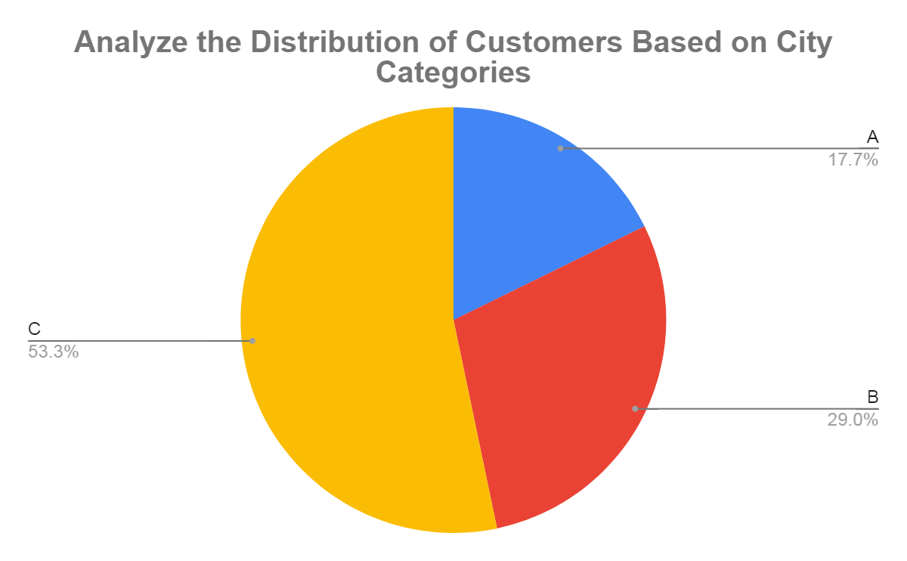
The highest Customers 53% are from city category C.
Findings:-
It indicates that the highest concentration of customers in city C and it is approximately 53.3 % of total customers base.
Insights:-
Focus marketing efforts on under-represented categories to expand the customer base.
Conduct market research to understand the demographics and needs of each city category. this can guide future marketing strategies and product development.

Slide 8
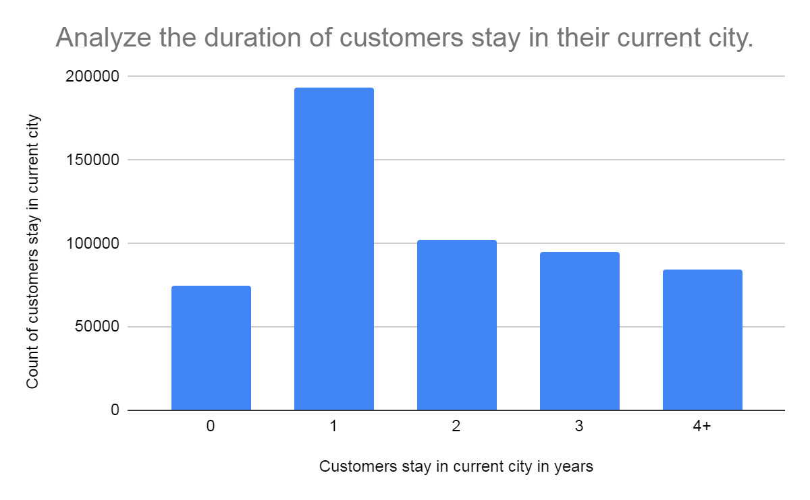
Most of the Customers, Who buy from Walmart stay 1-2 years in the city .
Findings:-
The number of stays has been increasing over the years. There are more stays in recent years (4+) compared to earlier years (0).
Around 35% of customers stay in their current city for less than a year.
Insights:-
The 35% of customers stay in their current city for less than a year, Reason could be job relocations, students moving for college or recent graduates starting their careers.
Businesses can target these customers with special offers or discounts To incentivize them to establish themselves with the company as a long-term customer.

Slide 9
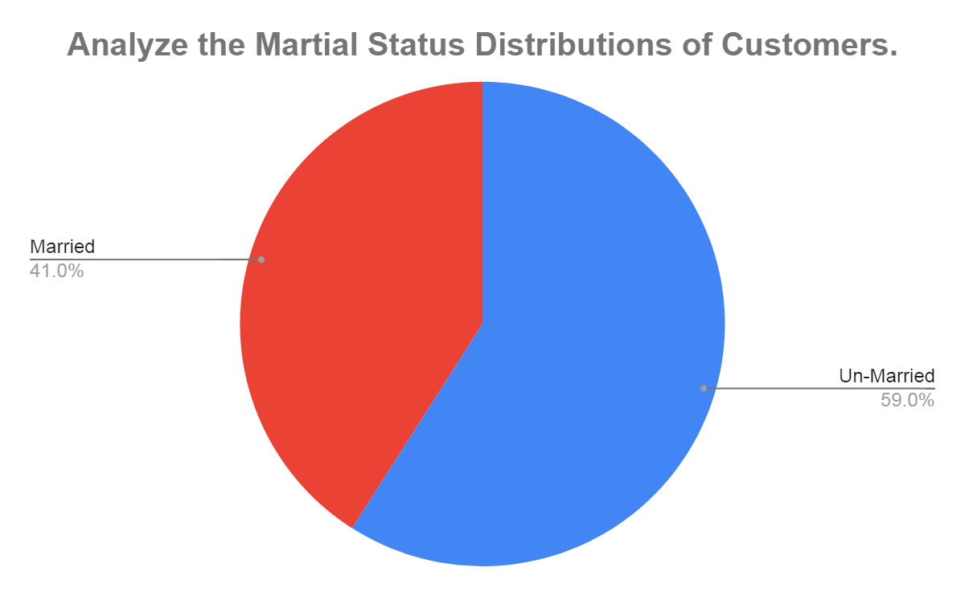
Most of the Customers are Single.
Findings:-
Un-Married customers make up the largest portion of the customer base, at 59%.
Married customers account for 41% of the customer base.
Insights:-
The business may want to tailor its marketing messages and offerings to appeal to married couples.
For example, they could promote products for couples or families.
The business should not neglect single customers, who also represent a significant portion of the
customer base.
They could target singles with marketing campaigns that promote products or services that cater to
their needs and interests.

Slide 10
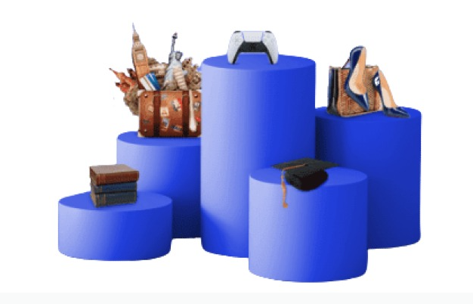
Which product are sold ?

Slide 11
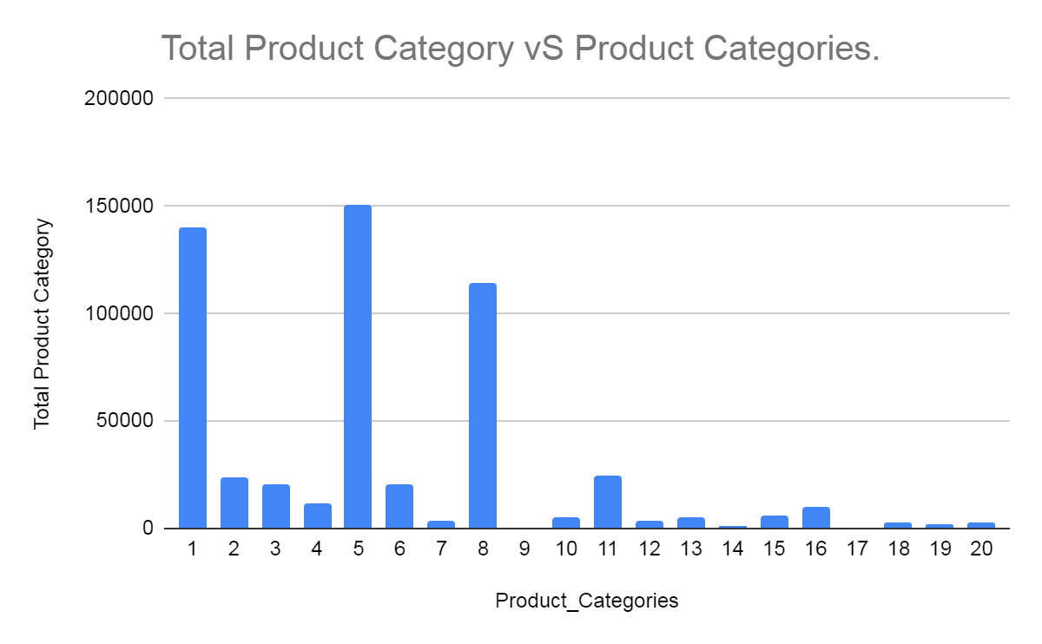
Most popular category is the 5 with highest purchase .
Findings:-
Most popular product category is 5 with 27.4 % of total product categories .
Insights:-
Focus on High-Performing Categories Business strategies could focus on maintaining or increasing the stock
and variety in the top-performing categories to maximize revenue.
Assess and Improve Low-Performing Categories For categories with low sales, further analysis might be
needed to understand the reasons behind the poor performance. Consider marketing efforts, product
quality, or even discontinuing certain products if they are not profitable.

Slide 12
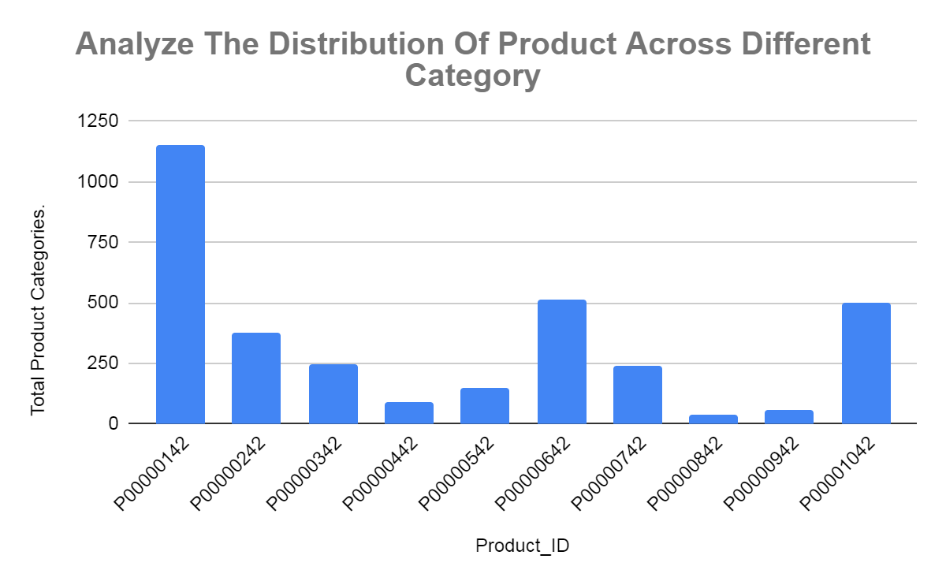
Product id P00000142 has the highest count .
Findings:-
The Product ID P0000042 has the highest count, significantly surpassing other products with over 1000
units. This indicates that P0000042 is either the most popular or the most stocked product in this dataset.
Insights:-
Conduct market research to understand why some products are less popular and adjust the product
offerings accordingly.
It’s essential to have a robust supply chain strategy to avoid stockouts.
For products with lower counts, ordering policies might need to be adjusted to avoid excess inventory
and reduce holding costs.

Slide 13
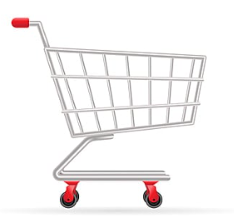
What do Customer’s purchase ?

Slide 14
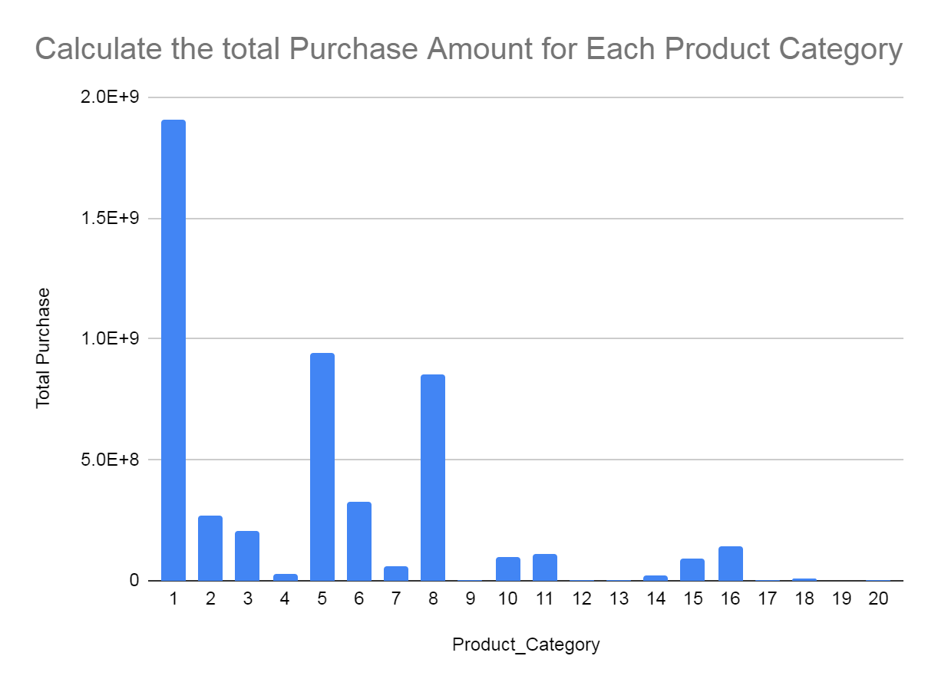
Exceptional Purchase Amount Observed in Product Category 1 Compared to Other Categories.
Findings:-
Product Category 1 has an exceptionally high total purchase amount compared to all Other categories.
It is the clear leader in terms of sales.
Insights:-
Since Category 1 generates the highest revenue, efforts should be concentrated on maintaining and
expanding its market share. This might involve increased marketing, promotions, or product enhancements.
For the lower-performing categories, a detailed market analysis might reveal the reasons for low sales.
It could be due to lack of awareness, higher competition, or insufficient product differentiation. Based on
the findings, strategic decisions could be made, such as rebranding, repositioning, or discontinuation.

Slide 15
Top 3 Product Categories Contribute 49% of Total Purchase Amount, Indicating High Concentration.
Product_ID | Total Purchase Amount
P00000142 | 12837476
P00000242 | 3967496
P00000342 | 1296475
P00000442 | 441173
P00000542 | 807212
P00000642 | 7635578
P00000742 | 1453565
P00000842 | 360314
P00000942 | 581125
P00001042 | 6922380
Identified the top 10 products by purchase amount.
Findings:-
The top 3 product categories together contribute 49% of the total purchase amount. This indicates a high
concentration of sales within these leading categories.
Insights:-
The top 3 product categories are the key revenue generators. Enhancing marketing efforts,
ensuring high availability, and potentially expanding these product lines could capitalize on their
popularity.
A significant portion of sales coming from a few top products, diversifying the product portfolio could
mitigate risks. Developing new products or improving underperforming ones can help in reducing
dependency on the top sellers.

Slide 16
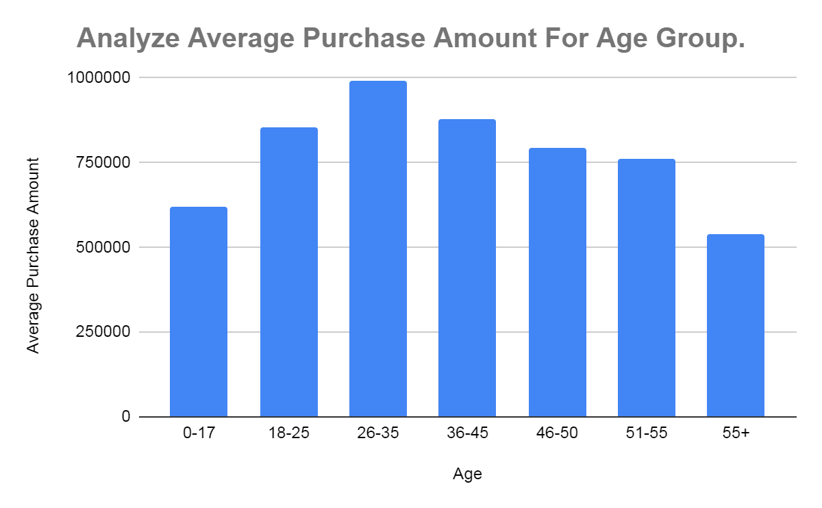
Age Group 26-35 Leads in Average Purchase Amount, Indicating Highest Spending Segment .
Findings:-
The age group 26-35 has the highest average purchase amount, indicating that this segment spends the
most on average compared to other age groups.
Insights:-
Businesses should focus their marketing and promotional efforts on the age groups, as 18-35
these segments exhibit the highest average spending.
While focusing on high-spending age groups, ensure that promotions and product offerings are inclusive of
all age groups to maintain a balanced customer base.

Slide 17
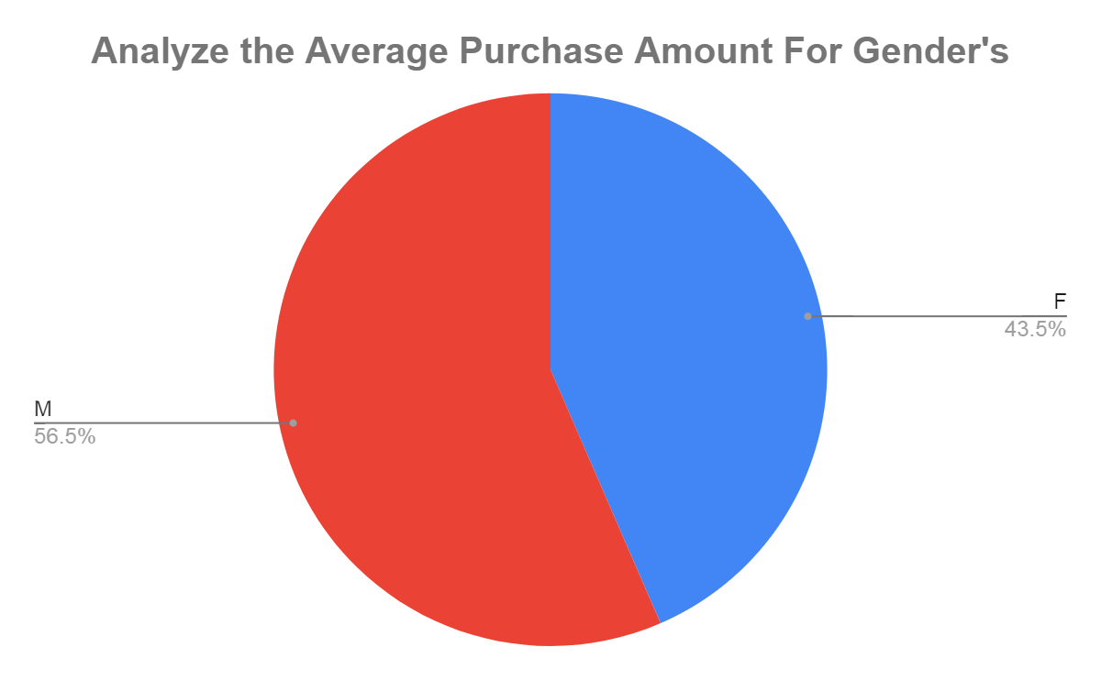
Male Dominance in Purchases: Males Account for 56.5% of Average Purchase Amount
Findings:-
Male Dominance in Purchases, Males account for 56.5% of the average purchase amount.
Male customers represent the majority in terms of average purchase amount, indicating they spend more
on average compared to female customers.
Insights:-
Develop marketing strategies that resonate with both genders but emphasize males slightly due to their
higher contribution.
Explore opportunities to increase the female customer base and their purchase amounts through targeted
campaigns.

Slide 18
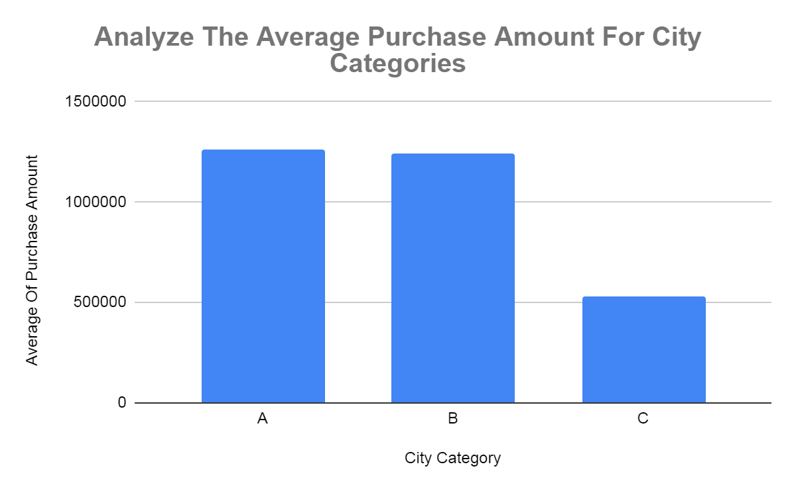
City Category A Leads in Average Purchase Amount, Indicating Higher Purchasing Power in Urban or Affluent Areas.
Findings:-
Customers in City Category A have the highest average purchase amount. This suggests that City
Category A likely represents urban or more affluent areas where consumers have higher purchasing
power.
City Category B follows closely behind City Category A in terms of average purchase amount.
Insights:-
Focus marketing and promotional efforts on City Categories A and B to leverage the higher purchasing power
and maximize revenue.
Continuously monitor and analyze purchasing patterns in these city categories to adjust strategies
dynamically and respond to market changes effectively.

Slide 19
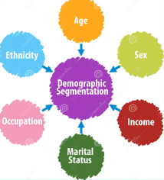
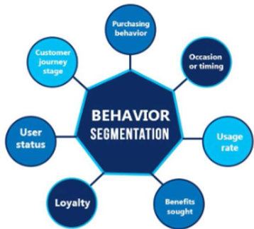
Customer Segmentation:-

Slide 20
Customer Segmentation Approach
Calculated the purchase amounts at various percentiles (e.g., 0 to 100th percentile) to understand the distribution of spending across our customer base.
These percentiles represent different levels of spending behavior, from low to high.
Low Spenders (0th to 50th Percentile: $744 - $41,146).
Medium Spenders (50th to 70th Percentile: $41,146 - $73,683.4).
High Spenders (70th to 95th Percentile: $73,683.4 - $2,22,996.8).
Loyal Spenders (Top 5 Percentile: $2,22,996.8 - $6,02,921).

Slide 21
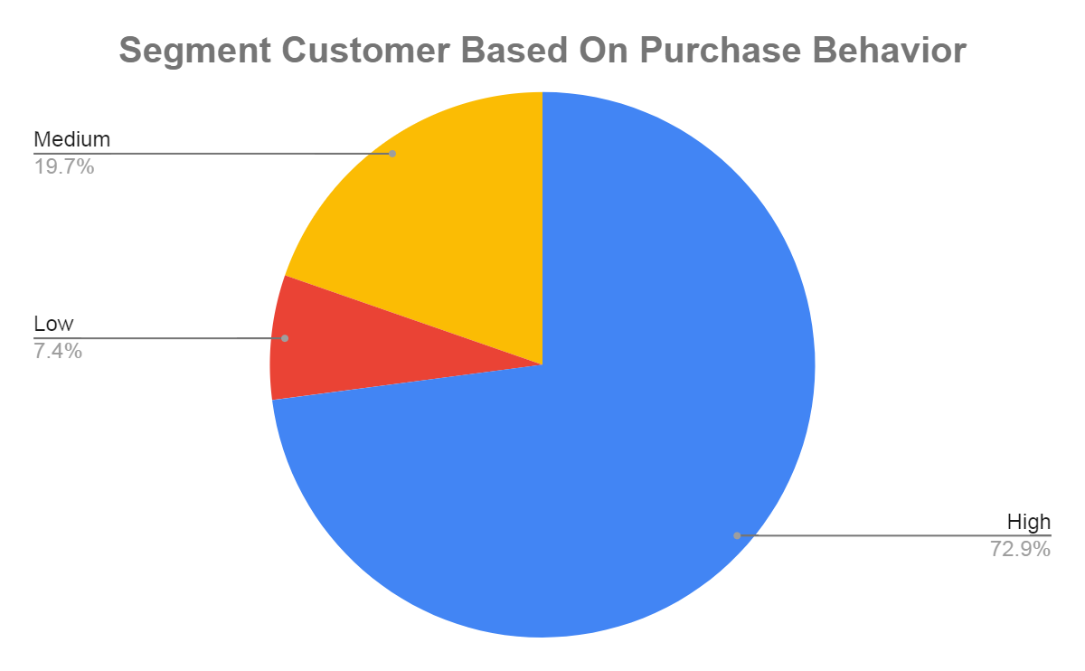
72.9% of Customers Exhibit High Purchase Behavior.
Findings:-
A significant majority of customers (72.9%) fall into the High purchase behavior category.
Insights:-
Since the majority of customers (72.9%) are in the High purchase behavior category, the business should
prioritize maintaining and enhancing the experience for these high-value customers. This can include
personalized offers, loyalty programs, and exclusive benefits to keep them engaged and loyal.
Retaining High purchase behavior customers should be a top priority, as they likely contribute a significant
portion of revenue. Ensuring high satisfaction and addressing any issues promptly can prevent churn.

Slide 22
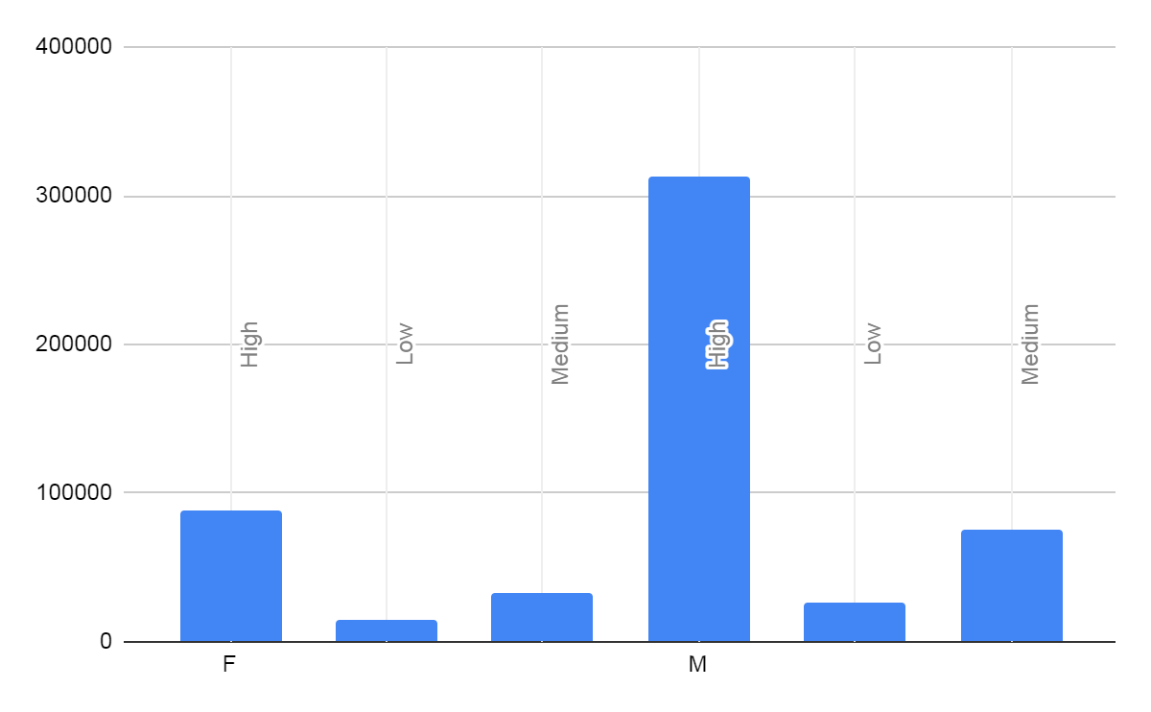
Males Dominate High Purchase Behavior Category with Highest Count.
Segment Customers Based on Demographics- Gender
Findings:-
Males in the High purchase behavior category have the highest count, significantly surpassing other
segments.
Insights:-
Since males in the High purchase behavior category dominate, the business should focus on retaining
these high-value customers through personalized offers, loyalty programs, and exclusive benefits.
Ensuring their satisfaction can lead to sustained revenue.
Implement personalized marketing strategies based on gender and purchase behavior to enhance
customer experience and drive sales. Understanding the specific preferences and behaviors of each
segment allows for more effective communication and offers.

Slide 23
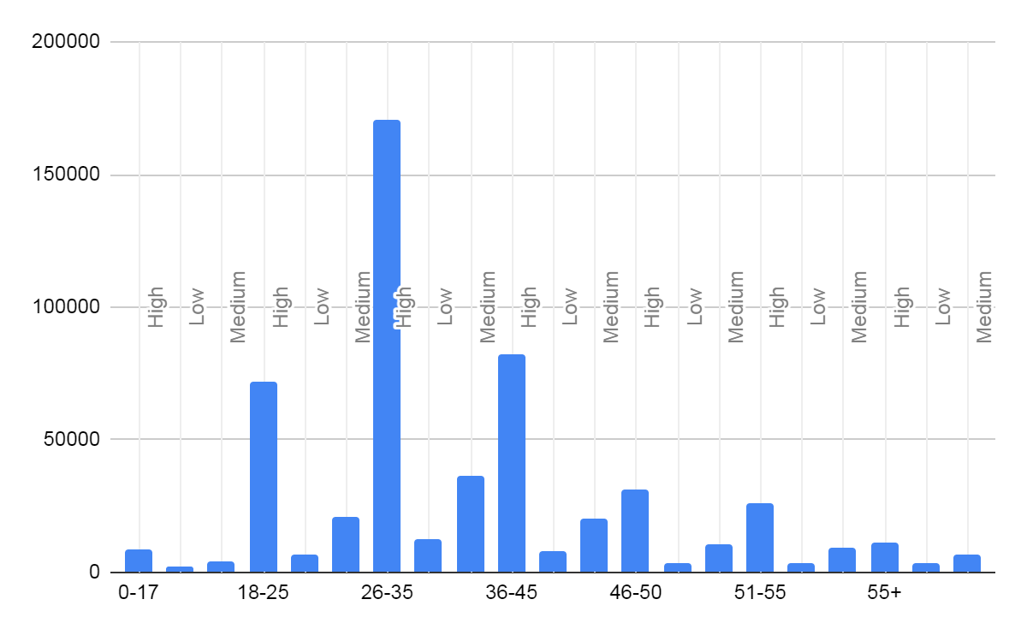
High Spenders Predominantly Aged 26-35, Significantly Surpassing Other Age Groups.
Segment Customers Based on Demographics- Age.
Findings:-
High spender are from 26-35 age group with highest value, significantly higher than all other groups.
Insights:-
The 26-35 age group should be a primary target for marketing efforts due to their significantly higher
engagement or consumption.
Tailoring products, advertisements, and campaigns to this demographic can potentially yield high returns.

Slide 24
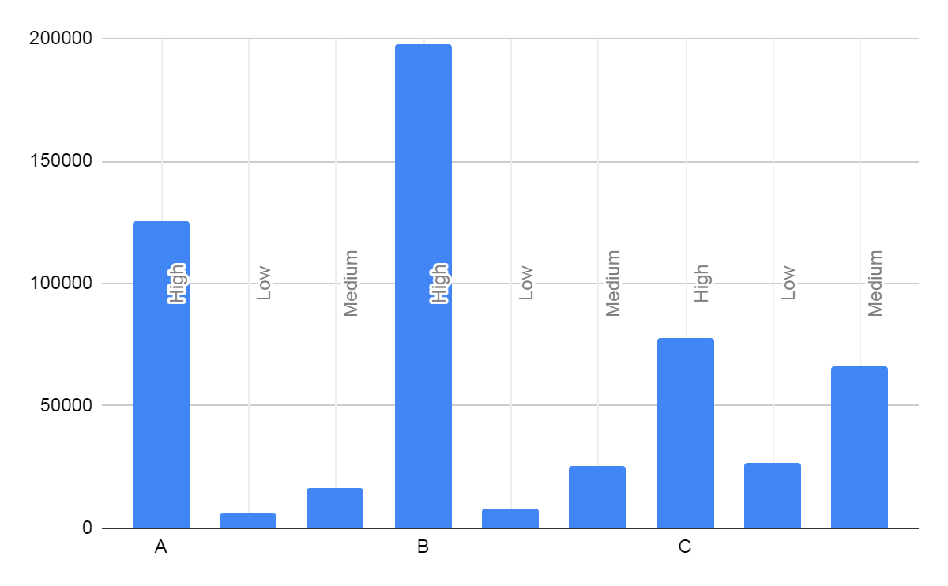
City Category B Holds Highest Value, Significantly Surpassing All Other Categories.
Segment Customers Based on Demographics- City Categories.
Findings:-
The city category B has the highest value, significantly higher than all other categories.
Insights:-
The data suggests that Category B is a standout performer, particularly in the 'High' and 'Medium’
subcategories, making it a potential focal point for strategic initiatives and investments.
Categories A and C, while showing potential, may need targeted strategies to enhance their performance,
particularly in the lower-performing subcategories.

Slide 25


